Slide 1
Artificial Intelligence–Assisted System in Postoperative Follow-up of Orthopedic Patients: Exploratory Quantitative and Qualitative Study
Sindie Zinhle Shongwe
Professor: Kuo-Chung Chu
Date: 29 September 2020

Slide 2
Patient follow-up is an essential part of hospital ward management. With the development of deep learning algorithms, individual follow-up assignments might be completed by artificial intelligence (AI).
This paper developed an AI-assisted follow-up conversational agent that can simulate the human voice and select an appropriate follow-up time for quantitative, automatic, and personalized patient follow-up.
Patient feedback and voice information could be collected and converted into text data automatically.

Slide 3
Postoperative follow-up is an essential part of orthopaedic surgery.
Medical institutions can provide service for discharged postoperative patients through follow-up.
Traditional methods include phone calls, emails, visiting, and re-examination at clinic; all of these methods need a lot of medical resources.
With the development of AI and telemedicine, computers or mobile phones could be used to complete more and more of the follow-up work.

Slide 4
Manual Follow-Up
Follow-up with the control group was performed by phone.
Calls were made one by one depending on the availability of human resources.
The communication contents were consistent with the AI-assisted follow-up group.
Reports were recorded and uploaded manually.
Feedback from patients were recorded by the operator and reported to surgeons and nurses.

Slide 5
AI-Assisted Follow-Up System
The AI-assisted follow-up system obtained baseline information for each discharged patient including the ID number, gender, age, discharge date, diagnosis, telephone number, and caller location.
The system called patients via automated speech telephony delivery in batches from 8:30 AM to 8:30 PM every day allowing hundreds of calls to be made daily.
Interactions between the system and patients were based on machine learning, speech recognition, spoken language understanding, and human voice simulation technology.

Slide 6
AI-Assisted Follow-Up System
Communication contents included patient satisfaction in the hospital environment, nursing, and health education; wound recovery; functional training; postoperative complications; and other surgery-related medical consulting.
The system was able to identify dialects in different parts of China via speech recognition technology and voice information was converted into text in real time.
Surgeons and nurses could review the report and respond to patient feedback, if necessary.

Slide 7
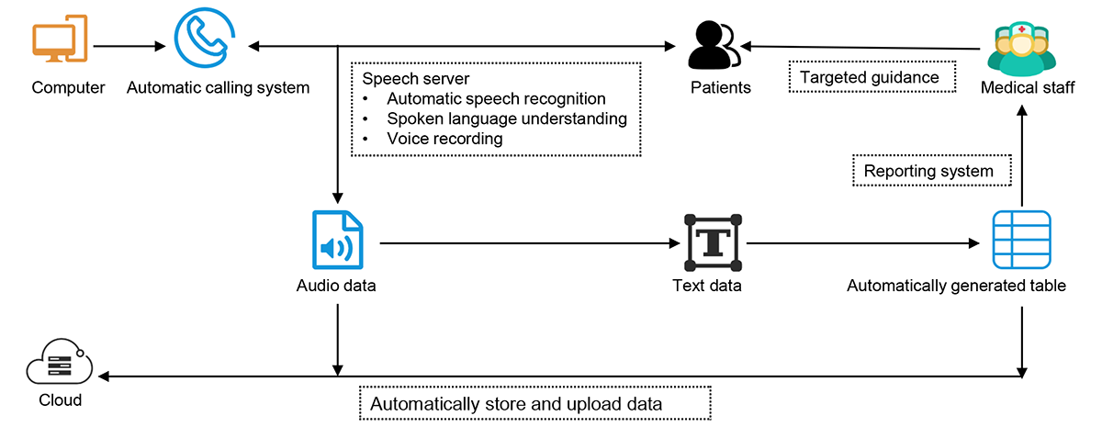
Block diagram of the AI-assisted follow-up system.

Slide 8
Transcription of a sample dialogue.
System: Hello, this is Peking union medical college hospital. Could you please take a few minutes to complete a follow-up survey? Thank you!
Patient: ok.
System: our follow-up questions mainly include three aspects: ward environment, propaganda, and nursing. All of the following questions are ranked from 0 to 5, with 5 being the most satisfactory and 1 being the worst. We will record your questions at the end of the follow-up, and would you please help us complete the complete survey?
Patient: yes, no problem.
System: what is your score for the quiet and tidy environment of the ward? The full score is 5 points.
Patient: well, give it a five.
System: ok, may I ask how satisfied you are with the ward environment introduction, health guidance, and the matters needing attention after discharge, etc., given by the nurses during your stay in the hospital? Would you please rate

Slide 9
Transcription of a sample dialogue.
Patient: well, give it a five.
System: ok, please rate the nurses' responsibility, fit degree, injection technique, regular patrol, response speed, and other nursing work.
Patient: well, five points.
System: ok, what are your complaints about this hospitalization?
Patient: perhaps the most unsatisfactory part is that the doctor is too busy and has too few opportunities to communicate with patients.
System: do you have any other questions for feedback or consultation?
Patient: no.
System: thank you very much for your cooperation. We have recorded your problems and will reply to you as soon as possible. Please keep your mobile phone free and remember to review it on time.

Slide 10
Automatically generated table for the dialogue above
Parameter | Information
Basic information | Patient name, ID number, gender, age, discharge date, diagnosis, and caller locationª
Dialogue result | System hang up after dialogue
Number of dials | 1
Call duration (s) | 97
Question 1 score | 5
Question 2 score | 5
Question 3 score | 5
Total score | 15
Feedback question | Doctors are too busy to communicate with patients
Follow-up date | 2019/6/24

Slide 11
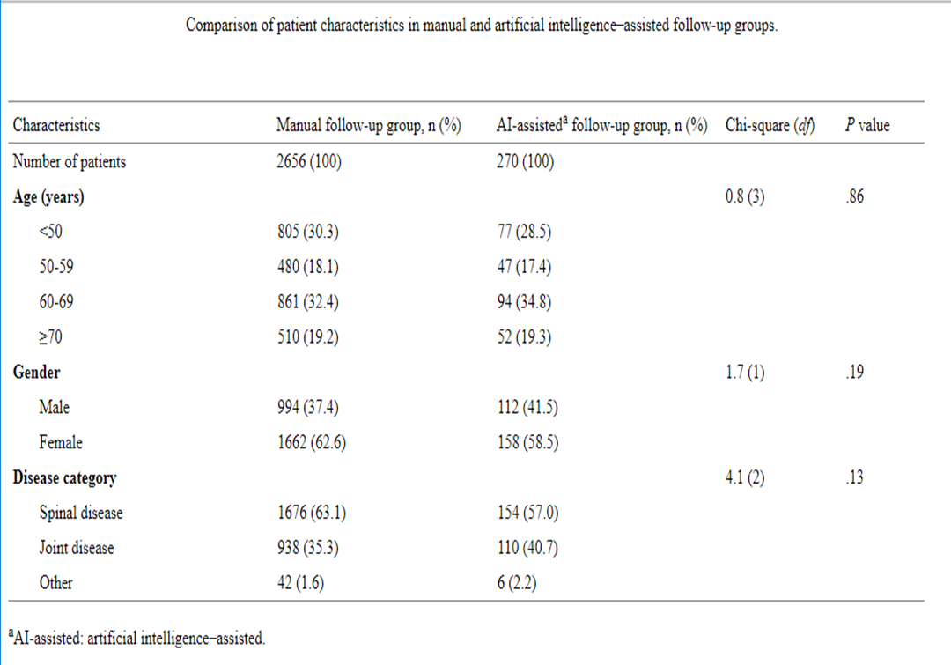
Results- Table 2

Slide 12
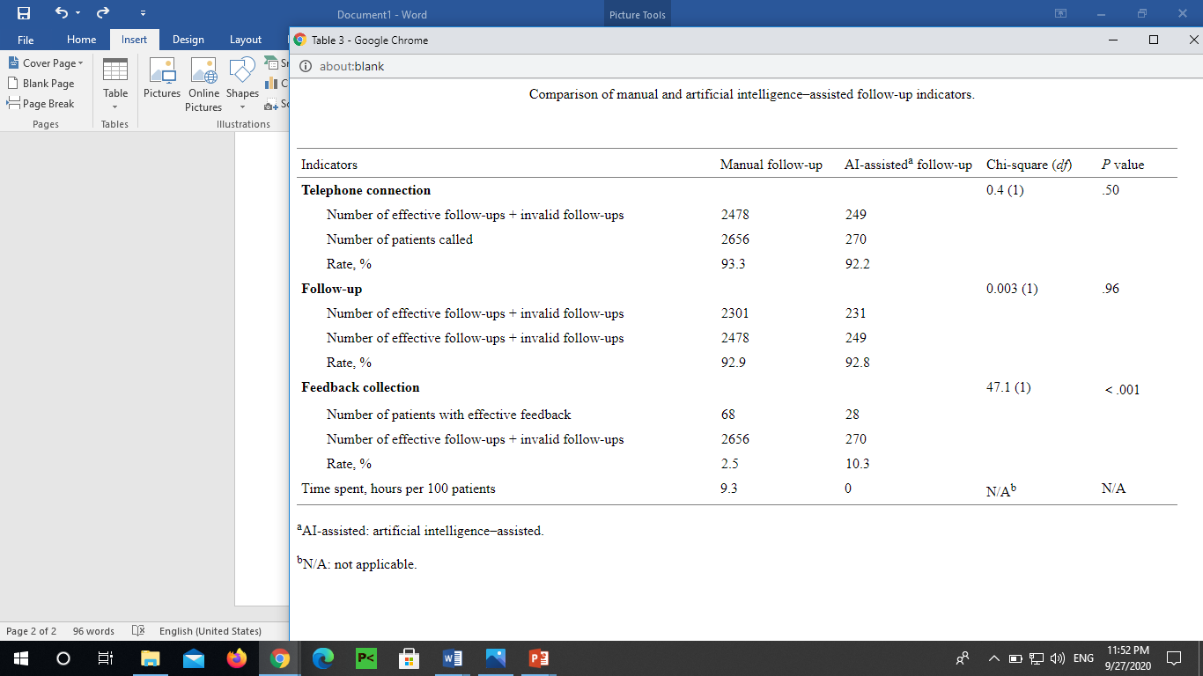
Table 3

Slide 13
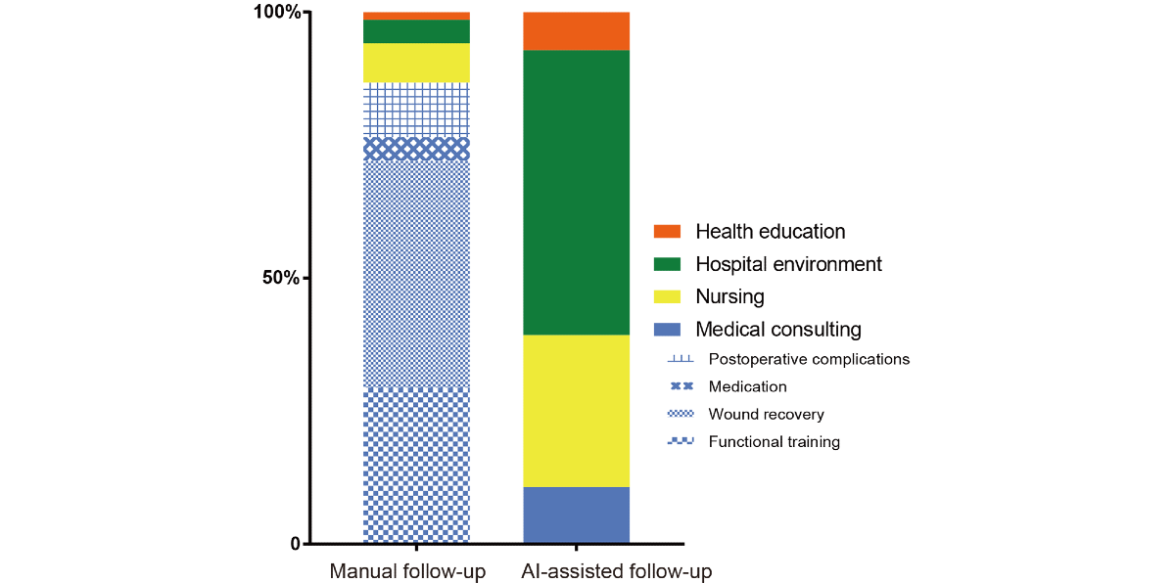
Composition of feedbacks in AI-assisted follow-up group and manual follow-up group

Slide 14
Discussion
In this research, we found that the effectiveness of AI-assisted follow-up was not inferior to the manual follow-up.
Moreover, human resources costs could be saved with the assistance of artificial intelligence.
Compared with manual follow-up, AI-assisted follow-up obtains more comprehensive feedback, but feedback lacks depth and pertinence.
Therefore, the application of an AI-assisted follow-up system in hospital ward management has the potential to improve telemedicine follow-up service and patient satisfaction.

Slide 15
Limitations
Our work has several limitations. First, apart from phone calls, there are other communication methods that could be combined with AI, such as text messages, computer software, and smartphone apps.
Therefore, future work may include developing a chatbot software or app for additional medical purposes and to provide better personal service.
The second limitation of this study is that the probation period of the AI-assisted follow-up system is not too long. It is generally believed that with the increasing of machine learning time, the AI-assisted system would become more intelligent. Therefore, we should pay more attention to this system in the future.

Slide 16
References
Bian Y, Xiang Y, Tong B, Feng B, Weng X
Artificial Intelligence–Assisted System in Postoperative Follow-up of Orthopedic Patients: Exploratory Quantitative and Qualitative Study
J Med Internet Res 2020;22(5):e16896
DOI: 10.2196/16896
PMID: 32452807
PMCID: 7284488

